Slide 1
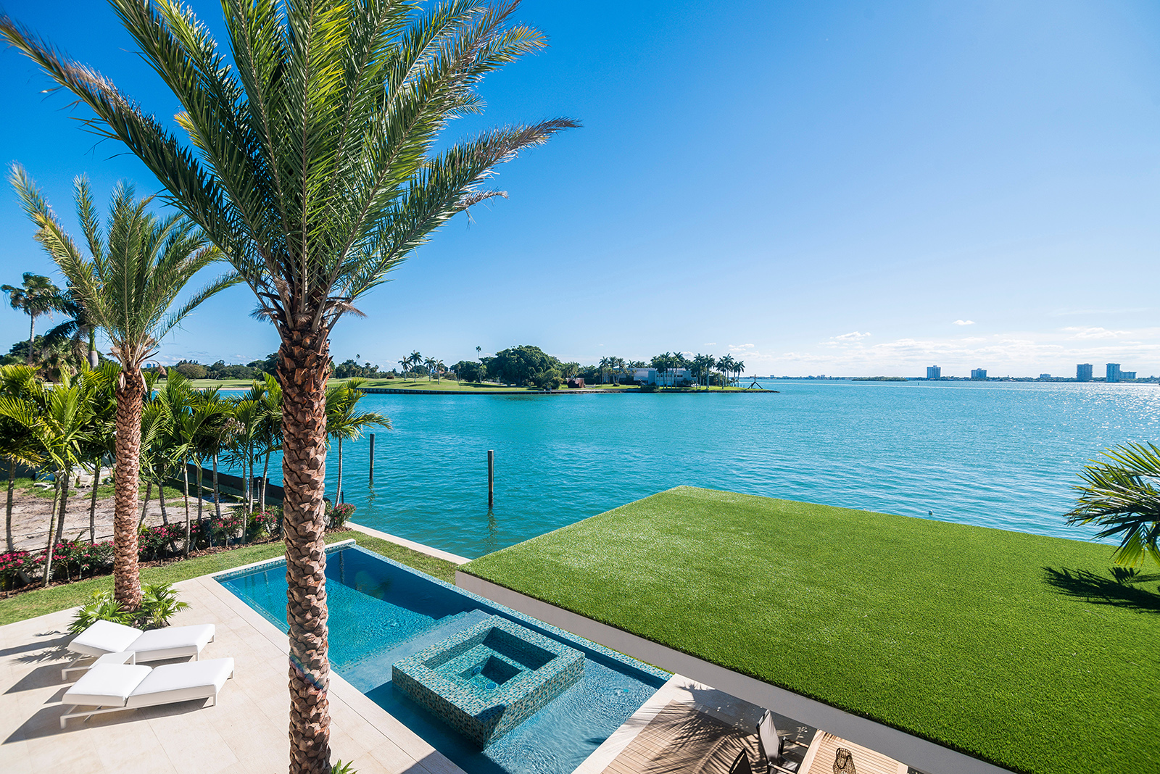

www.langrealty.com

Slide 2


Agent Name
Office: 999.999.9999
Cell: 999.999.9999
agent@langrealty.com
agent.langrealty.com
Exceptional Service.
Extraordinary Results.
Lang Office: Agent Office Location
Professional Experience: Industry Accolades, etc.
# of Years in Real Estate: XX Years
Area of Expertise: Country Clubs, Ocean, etc.
Qualities That Make Me a Real Estate Professional:
Honesty, Integrity, Trust
Currently Live In: Community or Location
Additional Info: Add Info Here

Slide 3

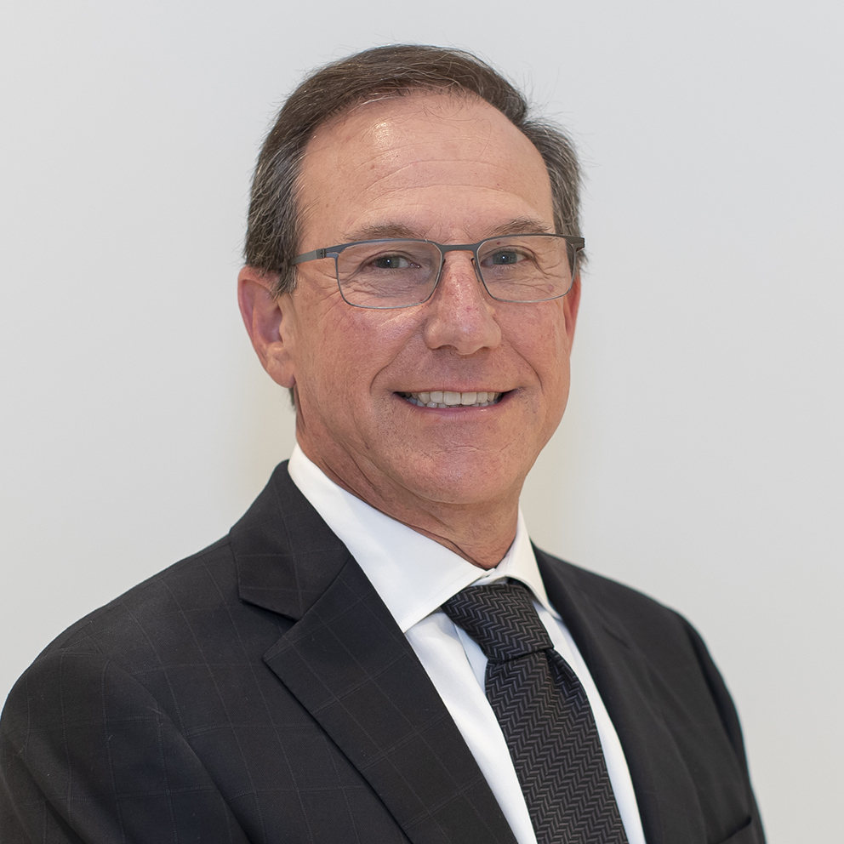
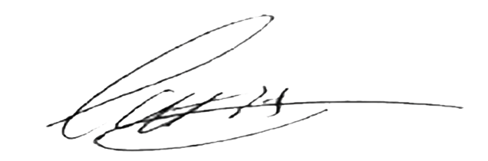
Honesty, Integrity, and Quality
These are the principles that guide us, and they cannot be compromised. Lang Realty strives to create an extraordinary real estate experience for our clients.
Warm Regards,
Scott Agran
President

Slide 4

Why Choose Lang Realty
With Over
$1 Billion
In Closed Sales Every Year
For The Past 10 Years
WE DELIVER RESULTS
A BOUTIQUE COMPANY
UNMATCHED MARKETING
Lang Realty is a Boutique Luxury Real Estate company with the power of a National Brand
Lang Realty dominates the South Florida market in both traditional & digital advertising
SALES
LOCAL EXPERTISE
Over $1 Billion in closed sales volume every year for the past 10 consecutive years
Our agents market knowledge is unparalleled
RANKED #5 IN VOLUME
SERVICE
A top listing leader in Palm Beach County
We provide all of our clients with best-in-class services; before, during, & after the transaction
*All reports published January 2023 based on data available at the end of December 2022. Reports pulled from Trendgraphix, Inc.

Slide 5
We Are South Florida
Real Estate
A Boutique Firm With A Global Reach
STRENGTH IN NUMBERS
Nearly 300 experienced, full-time real estate associates throughout Palm Beach, Broward, & St. Lucie counties.
Port St. Lucie
8305 Holley Tree Trail
Port St. Lucie, Florida 34986
772.467.1299
OUR TRACK RECORD
Since 1989, Lang Realty has offered a full-service real estate experience. We continually adapt and evolve to ensure maximum exposure for every property we represent.
Jupiter
920 W. Indiantown Rd. Suite 105
Jupiter, Florida 33458
561.623.1238
Boynton Beach
OUR FOOTPRINT
8855 Boynton Beach Blvd. Suite 340
Boynton Beach, Florida 33472
561.340.1200
A strong, robust South Florida presence, with 6 offices located
from Boca Raton to Port St. Lucie.
Delray Beach
900 E. Atlantic Avenue, Suite 16B
Delray Beach, Florida 33483
561.455.3300
EFFECTIVE MARKETING
Boca Raton
East Boca Raton
Lang Realty dominates the South Florida market in both traditional & digital advertising
6653 Jog Road
Boca Raton, Florida 33496
561.998.0100
4400 N. Federal Highway, Suite 100
Boca Raton, Florida 33431
561.447.0666
INDUSTRY LEADERS
The Lang Realty brand is instantly recognized & respected as the epitome of luxury real estate in South Florida.

Slide 6


Our Community Outreach
This heartfelt program channels resources to our local communities, inspiring our agents and staff to create meaningful change. Whether through financial aid, goods, services, or volunteering, we unite to make a profound impact. Discover our dedication to community betterment at LangCares.com, where our love for people and purpose shines bright.
LangCares.com

Slide 7
A Leader in Luxury Real Estate
A Global
Community
Of Local
Experts
Sevills
7K
CB Globals
LuxuryRealEstate.com
8K
33K
Christie’s
15K
Luxury Portfolio
Sotheby’s
19K
22K
Unmatched Global Network
• We have more properties over $1 Million USD than any other competitor
• 38 Countries and 125,000+ Sales Associates
• LuxuryRealEstate.com's top visitingcountries/territories: 230
Luxury Real Estate Magazine
• Distribution of 50,000 to high-net worth individuals around the world
• On international news stands in over 80 countries
• In International Airline Lounges around the world
• Sent to entertainment industry, celebrities, and more
• Email and Digital distribution of 400,000
ACTIVE LISTINGS
PRICED OVER $1,000,000
LANG + LUXURY REAL ESTATE* 25,126
*Lang Realty offers global reach through our luxury partnership with Luxuryrealestate.com.

Slide 8


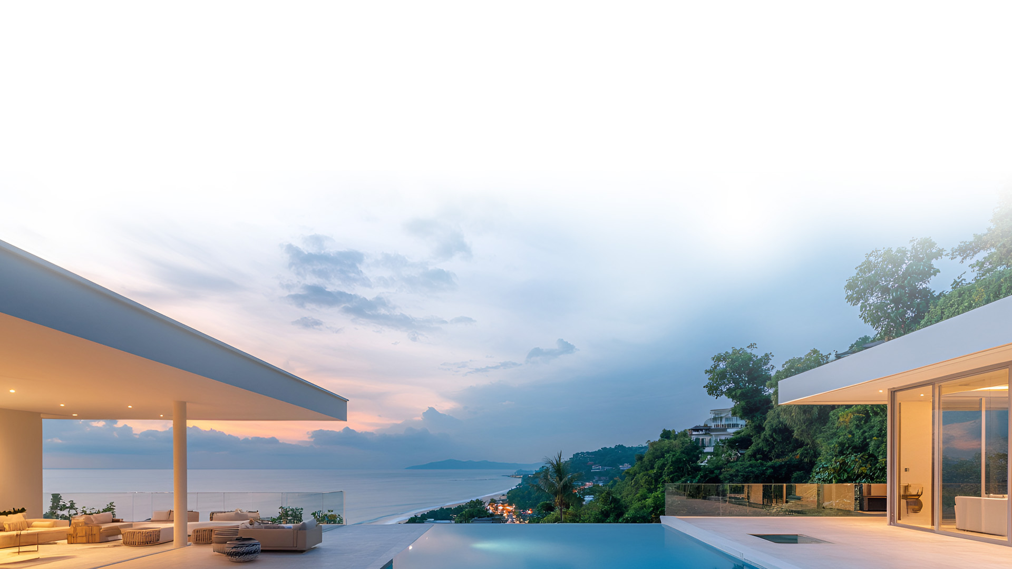

Global Reach
$300B+
IN SALES
130k+
LUXURY
REAL ESTATE
PROFESSIONALS
34k+
TOTAL
PROPERTIES
42+
COUNTRIES

Slide 9
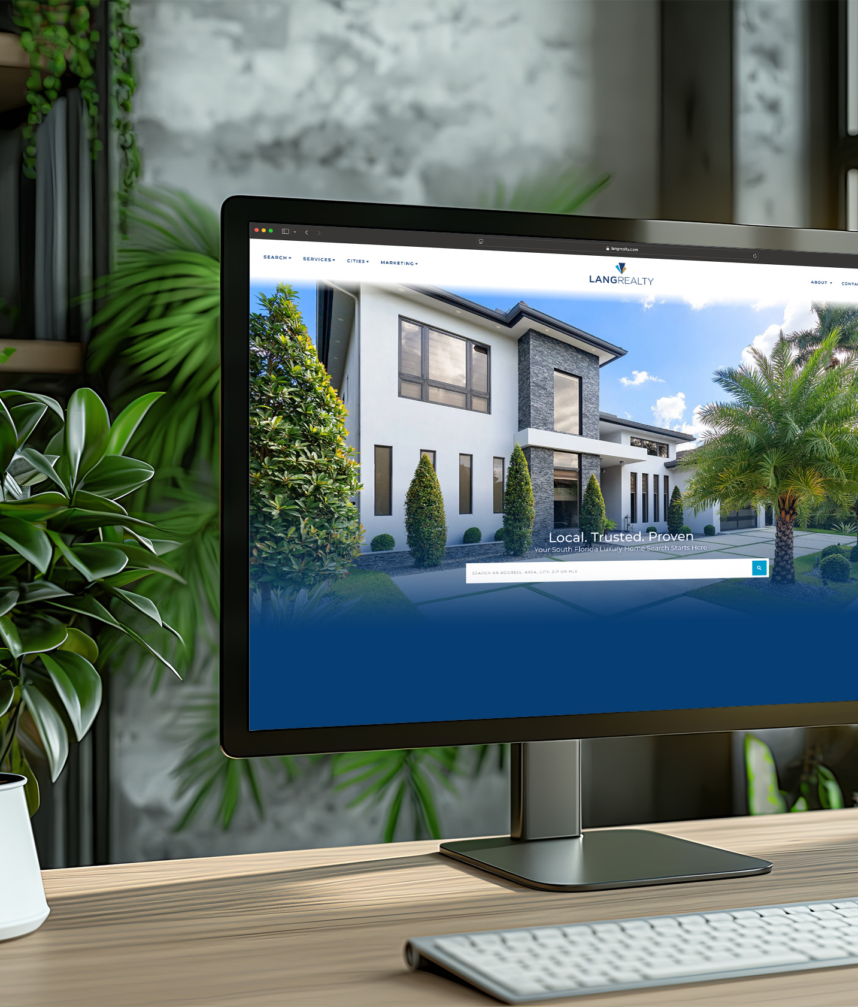
Digital Innovation
7.6M
LANGREALTY.COM
ANNUAL PAGEVIEWS
22M
INTERNATIONAL
AFFILIATE
ANNUAL PAGEVIEWS
84.6K
LANGREALTY.COM
MONTHLY
SESSIONS/VISITS
215K
INTERNATIONAL
AFFILIATE MONTHLY
SESSIONS/VISITS 15

Slide 10
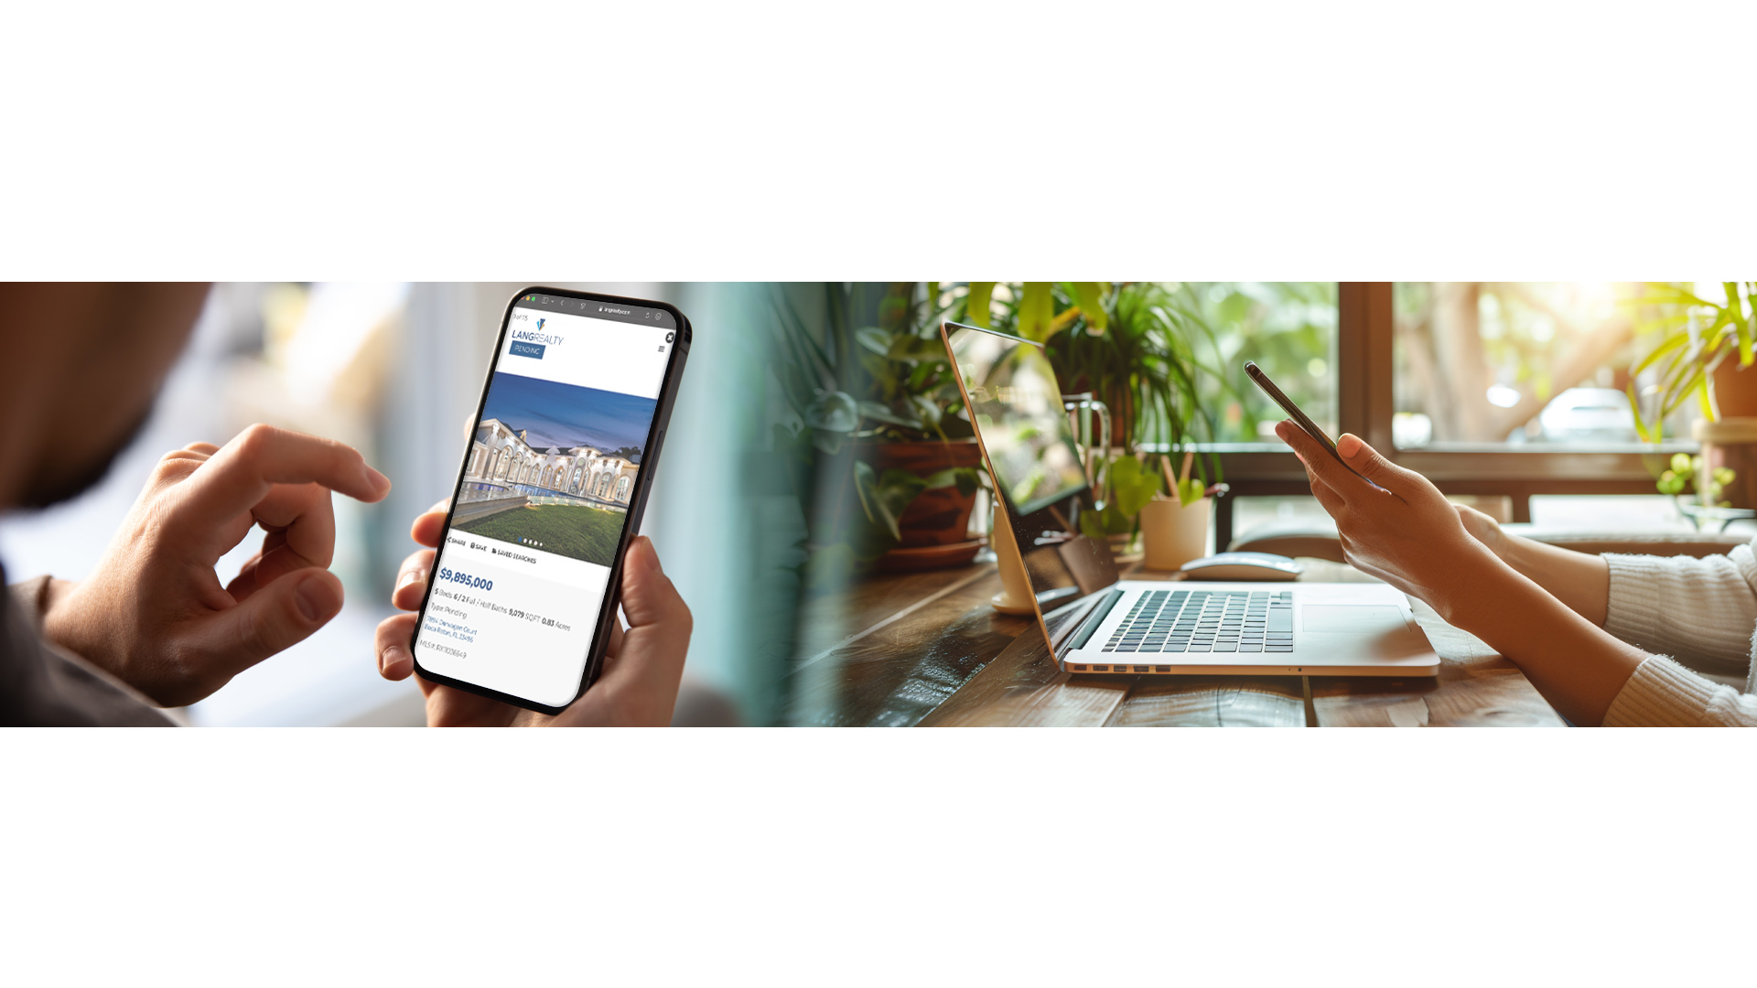
Social Media Outreach
Facebook
LinkedIn
Instagram
@LangRealty
#ListWithLang, #LangRealty

Slide 11








Where Your
Listings Will Be Found
Our Website Distribution Network
Global Distribution
Full Circle
Your listing will be shown on hundreds of real estate websites around the world.
All of our partner sites will redirect your listing and link back to our main site, LangRealty.com.
Real-time MLS Updates
Best in Class Analytics
Automatic daily updates from the Multiple Listing Service ensures that your listing will be front and center.
Lang Realty collects the traffic metrics from all of the publisher websites and compiles them into reports that provide your REALTOR® with critical marketing intelligence.

Slide 12








The Power of
Automated Intelligence
Our Best-in-Class Online Marketing Strategy
Automated Ad Distribution
Targeted Audience
After listing your home, a custom ad will be automatically created and distributed on Google, Facebook, and other relevant websites.
Your Listing will be put in front of anyone who has looked for real estate, mortgage brokers, moving companies, and industry services in the local area and follow them onto websites like Yahoo, the Wall Street Journal, and all of the major news outlets.
*The automated system only creates ads for homes that list for $1 Million or more

Slide 13






Dominant
Local Exposure
The Local Advertising Leader
Local Leaders
Specializing in Waterfront Properties
Golf & Country Club Properties
$1 Million+ Properties
Luxury Condominiums
Gated Communities
New Construction
Local Exposure
Direct Mail Marketing
Magazine Advertising

Slide 14





Beyond the Sale…
We’ve Got You Covered
With our premiere partners, we’ve made it easier
than ever to insure a smooth transaction
New Dawn
Title Group
Supreme Lending
Mortgage Lenders
Acentria Insurance
Home owners
Insurance
KTitle
Port St. Lucie
Title Company

Slide 15
What My Clients Are Saying
Name Goes Here
Name Goes Here
Body text Goes here here here
Body text Goes here here here
Body text Goes here here here
Body text Goes here here here
Body text Goes here here here
Body text Goes here here here
Body text Goes here here here
Body text Goes here here here
Body text Goes here here here
Body text Goes here here here
Body text Goes here here here
Body text Goes here here here
Name Goes Here
Name Goes Here
Body text Goes here here here
Body text Goes here here here
Body text Goes here here here
Body text Goes here here here
Body text Goes here here here
Body text Goes here here here
Body text Goes here here here
Body text Goes here here here
Body text Goes here here here
Body text Goes here here here
Body text Goes here here here
Body text Goes here here here

