Slide 1
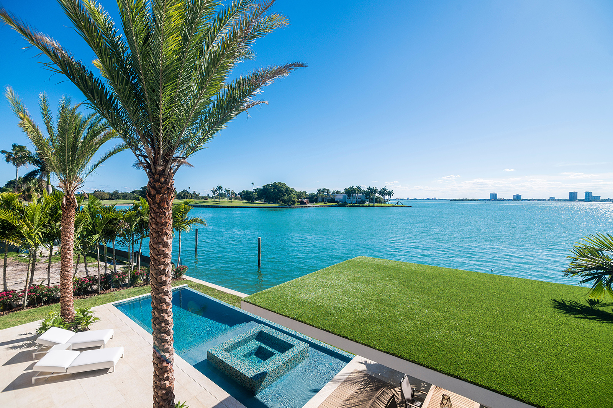
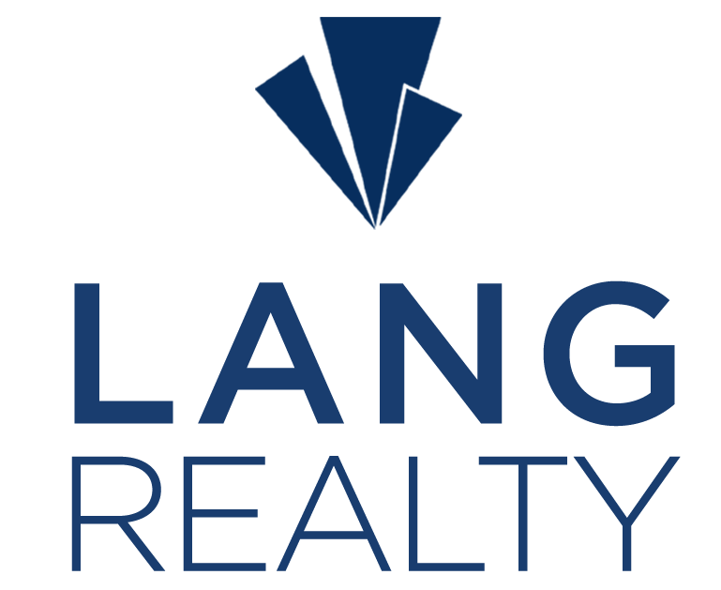


www.langrealty.com

Slide 2


Exceptional Service.
Extraordinary Results.
Lang Office: Agent Office Location
Professional Experience: Industry Accolades, etc.
# of Years in Real Estate: XX Years
Area of Expertise: Country Clubs, Ocean, etc.
Agent Name
Qualities That Make Me a Real Estate Professional:
Honesty, Integrity, Trust
Office: 999.999.9999
Cell: 999.999.9999
agent@langrealty.com
agent.langrealty.com
Currently Live In: Community or Location
Additional Info: Add Info Here

Slide 3
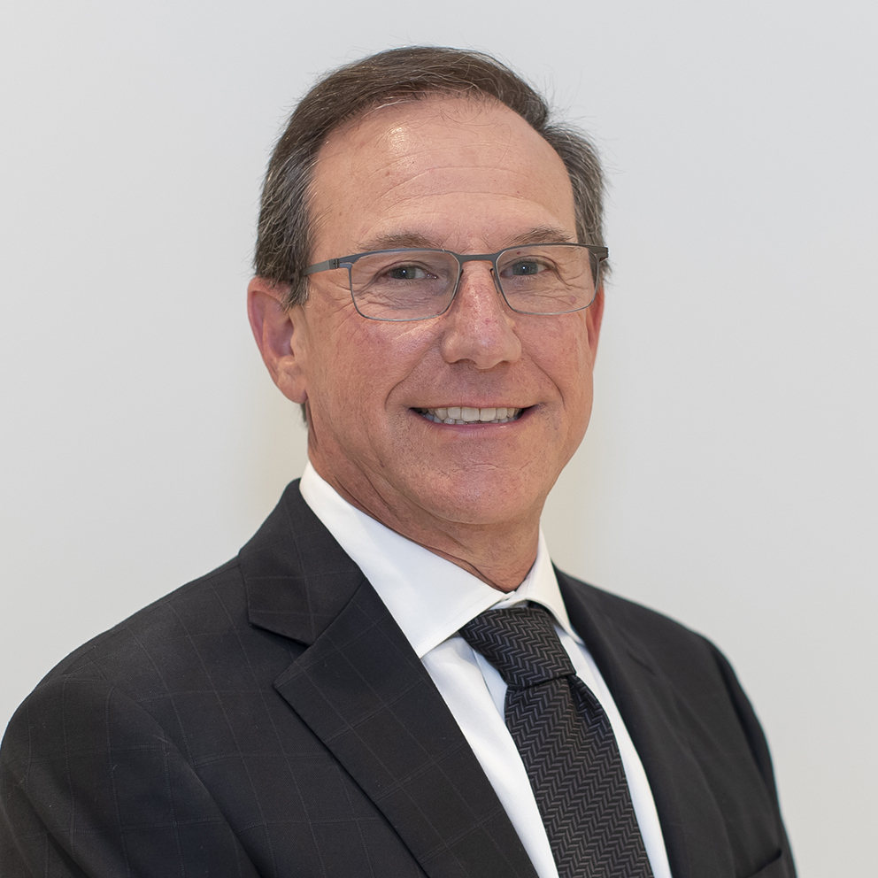
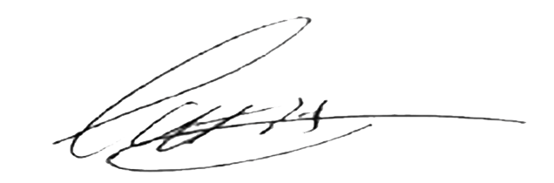
Honesty, Integrity, and Quality
These are the principles that guide us, and they cannot be compromised.
Lang Realty strives to create an extraordinary real estate experience for our clients.
Warm Regards,
Scott Agran
President

Slide 4

Why Choose Lang Realty
A BOUTIQUE COMPANY
Lang Realty is a Boutique Luxury Real Estate company with the power of a National Brand
With Over
$1 Billion
In Closed Sales Every Year
For The Past 10 Years
SALES
Over $1 Billion in closed sales volume every year for the past 10 consecutive years
RANKED #5 IN VOLUME
A top listing leader in Palm Beach County
UNMATCHED MARKETING
WE DELIVER RESULTS
Lang Realty dominates the South Florida market in both traditional & digital advertising
LOCAL EXPERTISE
Our agents market knowledge is unparalleled
SERVICE
We provide all of our clients with best-in-class services; before, during, & after the transaction
*All reports published January 2023 based on data available at the end of December 2022. Reports pulled from Trendgraphix, Inc.

Slide 5
We Are South Florida
Real Estate
A Boutique Firm With A Global Reach
Port St. Lucie
8305 Holley Tree Trail
Port St. Lucie, Florida 34986
772.467.1299
STRENGTH IN NUMBERS
Nearly 300 experienced, full-time real estate associates
throughout Palm Beach, Broward, & St. Lucie counties.
Jupiter
920 W. Indiantown Rd. Suite 105
Jupiter, Florida 33458
561.623.1238
OUR TRACK RECORD
Since 1989, Lang Realty has offered a full-service real estate experience. We continually adapt and evolve to ensure maximum exposure for every property we represent.
Boynton Beach
8855 Boynton Beach Blvd. Suite 340
Boynton Beach, Florida 33472
561.340.1200
OUR FOOTPRINT
Delray Beach
900 E. Atlantic Avenue, Suite 16B
Delray Beach, Florida 33483
561.455.3300
A strong, robust South Florida presence, with 6 offices located
from Boca Raton to Port St. Lucie.
Boca Raton
6653 Jog Road
Boca Raton, Florida 33496
561.998.0100
East Boca Raton
EFFECTIVE MARKETING
4400 N. Federal Highway, Suite 100
Boca Raton, Florida 33431
561.447.0666
Lang Realty dominates the South Florida market in both traditional & digital advertising
INDUSTRY LEADERS
The Lang Realty brand is instantly recognized & respected as the epitome of luxury real estate in South Florida.

Slide 6


Our Community Outreach
This heartfelt program channels resources to our local communities, inspiring our agents and staff to create meaningful change. Whether through financial aid, goods, services, or volunteering, we unite to make a profound impact. Discover our dedication to community betterment at LangCares.com, where our love for people and purpose shines bright.
LangCares.com

Slide 7
A Leader in Luxury Real Estate
A Global Community
Of Local Experts
Sevills
Unmatched Global Network
7K
CB Globals
• We have more properties over $1 Million USD than any other competitor
• 38 Countries and 125,000+ Sales Associates
• LuxuryRealEstate.com's top visitingcountries/territories: 230
8K
LuxuryRealEstate.com
33K
Christie’s
Luxury Real Estate Magazine
15K
• Distribution of 50,000 to high-net worth individuals around the world
• On international news stands in over 80 countries
• In International Airline Lounges around the world
• Sent to entertainment industry, celebrities, and more
• Email and Digital distribution of 400,000
Luxury Portfolio
Sotheby’s
19K
22K
ACTIVE LISTINGS
PRICED OVER $1,000,000
LANG + LUXURY REAL ESTATE* 25,126
*Lang Realty offers global reach through our luxury partnership with Luxuryrealestate.com.

Slide 8
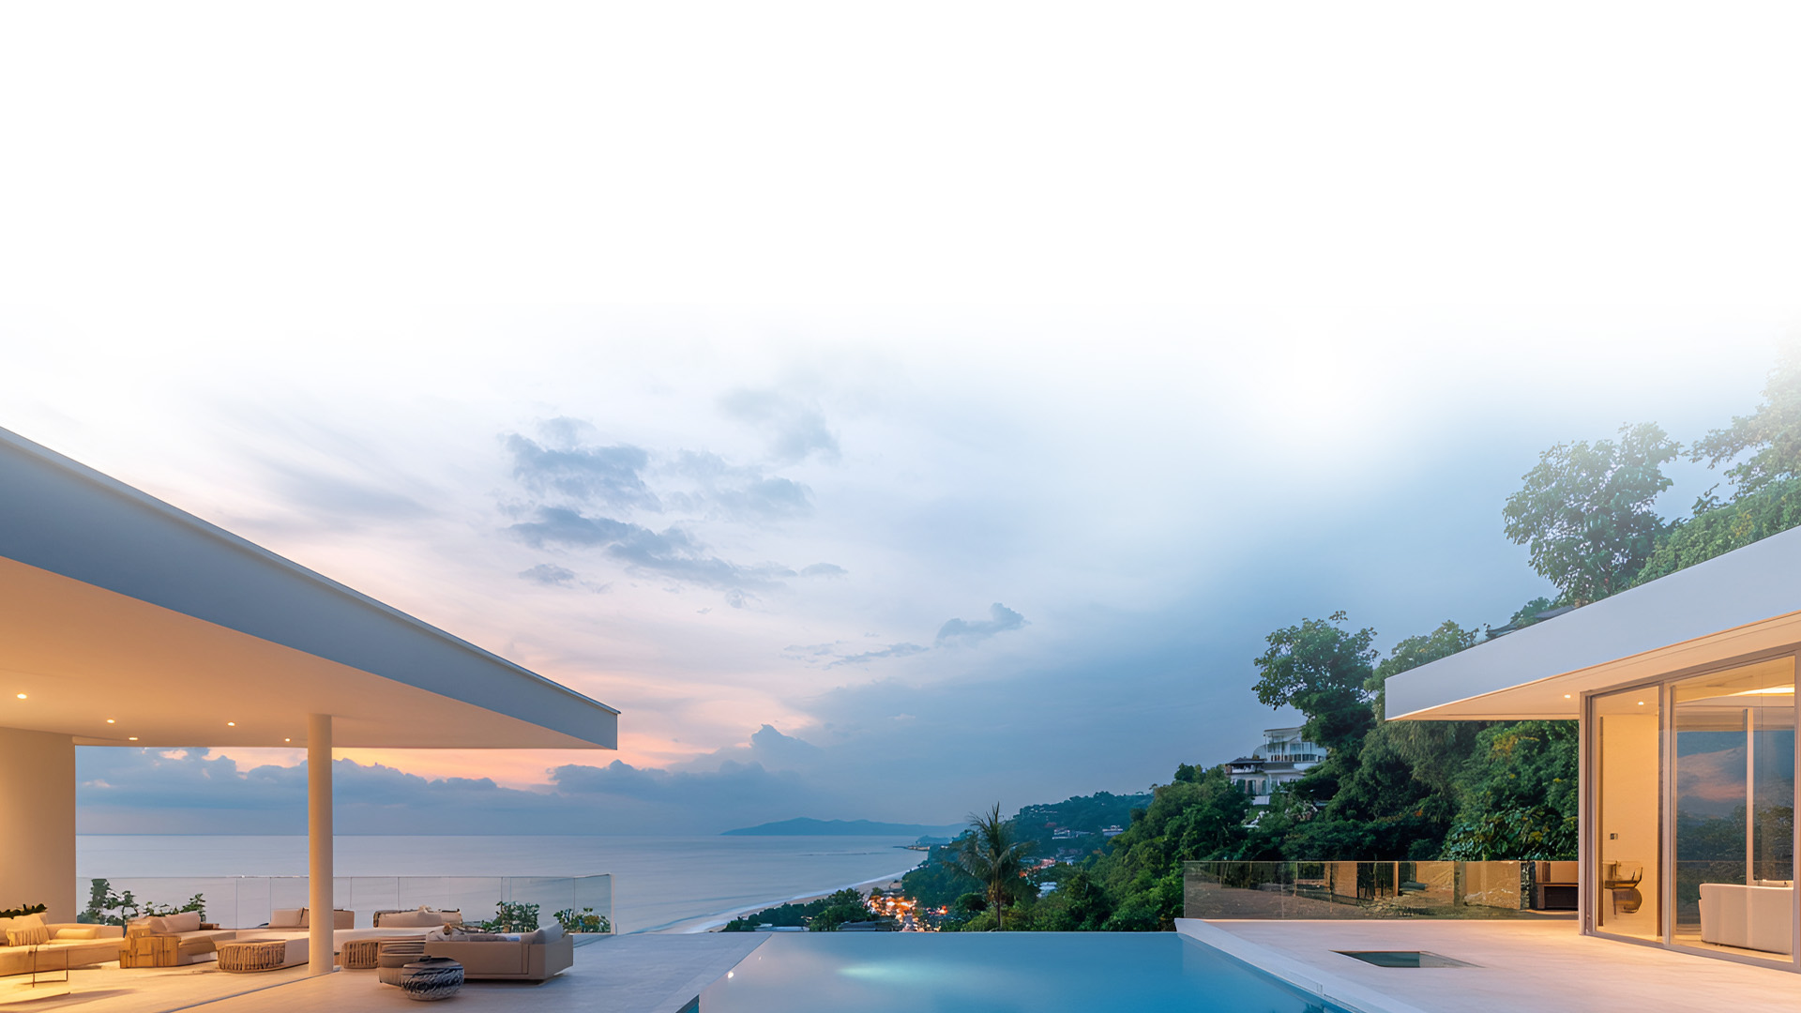



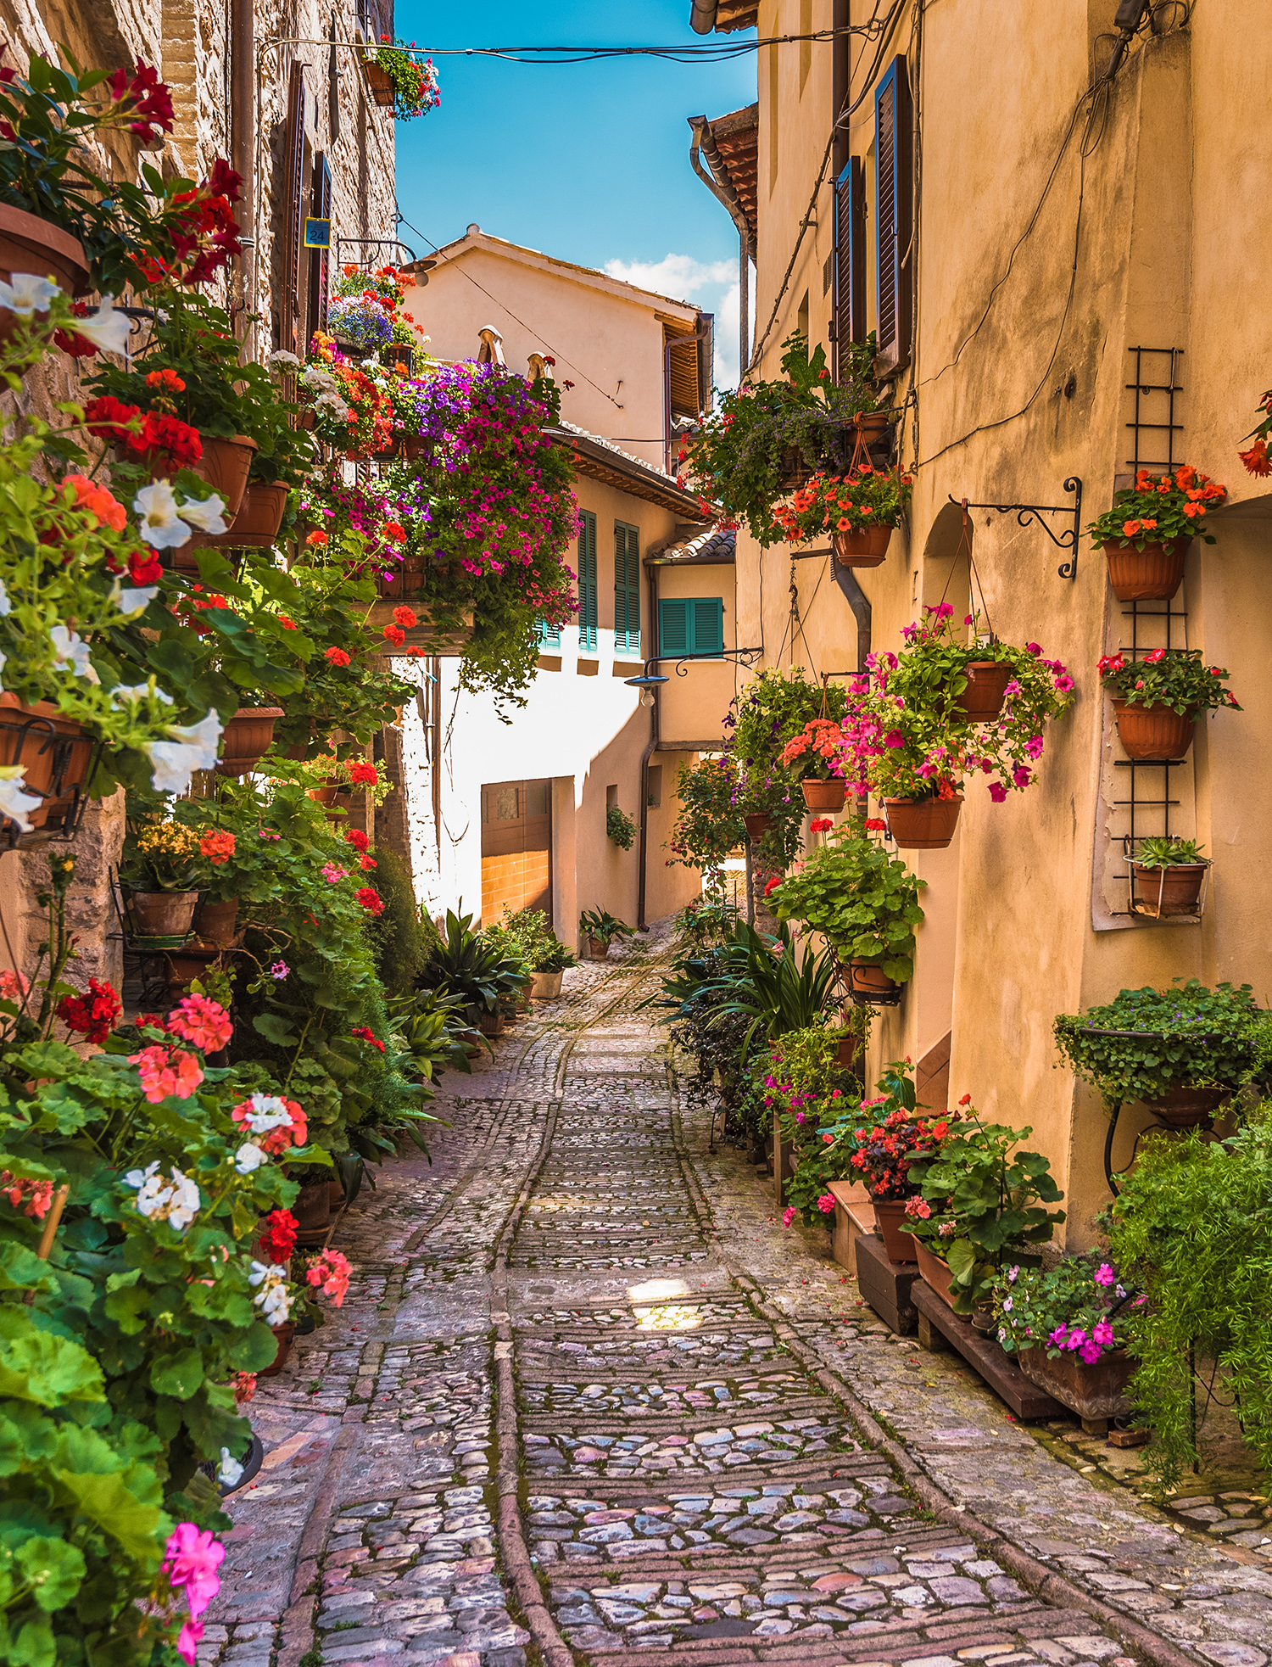
Global Reach
$300B+
130k+
34k+
42+
IN SALES
LUXURY
REAL ESTATE
PROFESSIONALS
TOTAL
PROPERTIES
COUNTRIES

Slide 9
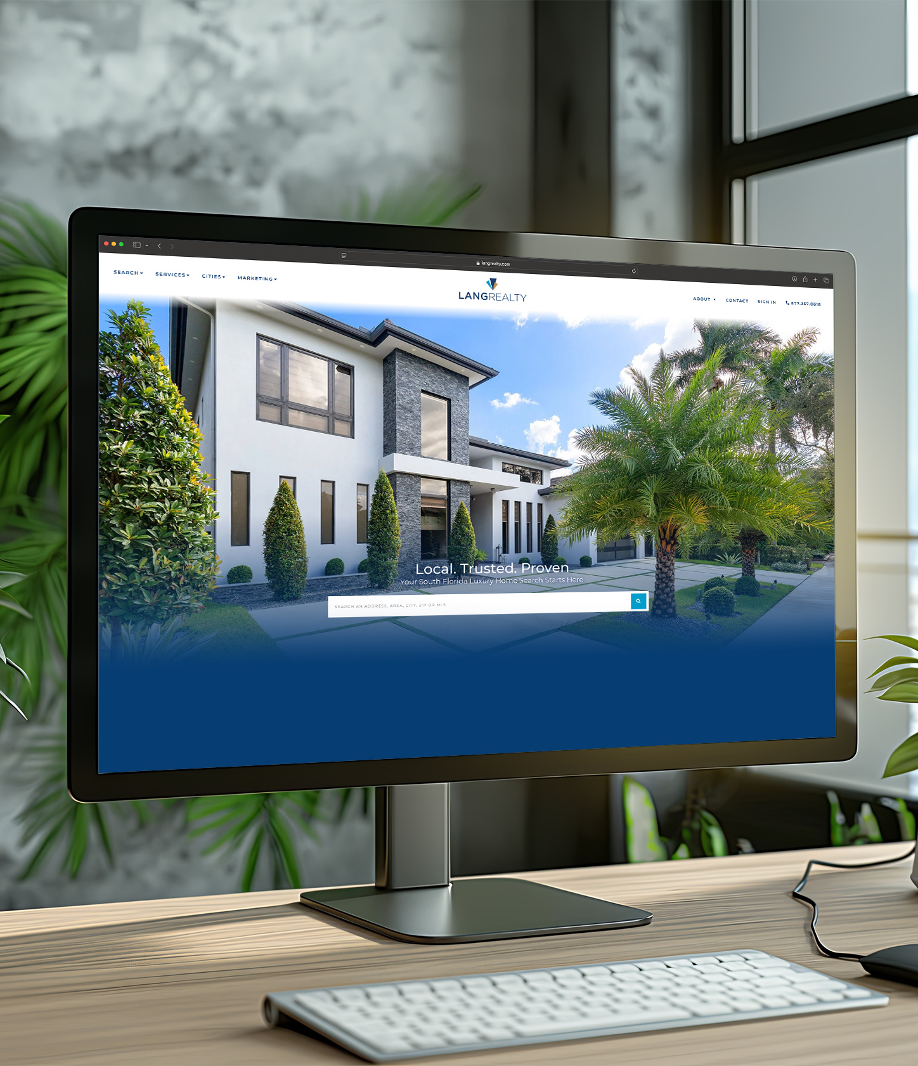
Digital Innovation
7.6M
84.6K
LANGREALTY.COM
ANNUAL PAGEVIEWS
LANGREALTY.COM
MONTHLY
SESSIONS/VISITS
22M
215K
INTERNATIONAL
AFFILIATE
ANNUAL PAGEVIEWS
INTERNATIONAL
AFFILIATE MONTHLY
SESSIONS/VISITS 15

Slide 10
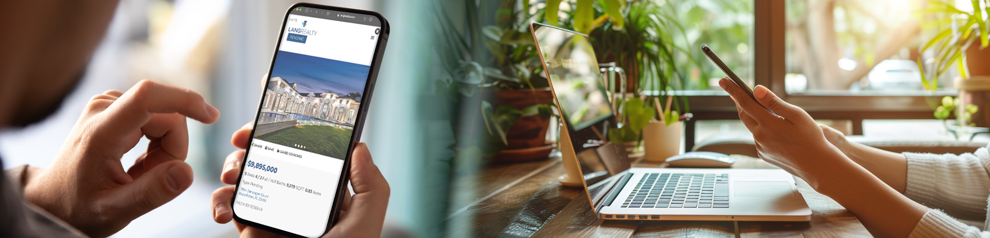
Social Media Outreach
Facebook
LinkedIn
Instagram
@LangRealty
#ListWithLang, #LangRealty

Slide 11








Where Your Listings Will Be Found
Our Website
Distribution Network
Global Distribution
Your listing will be shown on hundreds of real estate websites around the world.
Real-time MLS Updates
Automatic daily updates from the Multiple Listing Service ensures that your listing will be front and center.
Full Circle
All of our partner sites will redirect your listing and link back
to our main site, LangRealty.com.
Best in Class Analytics
Lang Realty collects the traffic metrics from all of the publisher websites and compiles them into reports that provide your REALTOR® with critical marketing intelligence.

Slide 12








The Power of Automated Intelligence
Our Best-in-Class Online Marketing Strategy
Automated Ad Distribution
After listing your home, a custom ad will be automatically created and distributed on Google, Facebook, and other relevant websites.
Targeted Audience
Your Listing will be put in front of anyone who has looked for real estate, mortgage brokers, moving companies, and industry services in the local area and follow them onto websites like Yahoo, the Wall Street Journal, and all of the major news outlets.
*The automated system only creates ads for homes that list for $1 Million or more

Slide 13






Dominant
Local Exposure
The Local Advertising Leader
Local Leaders
Local Exposure
Specializing in Waterfront Properties
Golf & Country Club Properties
$1 Million+ Properties
Luxury Condominiums
Gated Communities
New Construction
Direct Mail Marketing
Magazine Advertising

Slide 14





Beyond the Sale… We’ve Got You Covered
With our premiere partners, we’ve made it easier than ever to insure a smooth transaction
New Dawn
Title Group
Supreme Lending
Mortgage Lenders
Acentria Insurance
Home owners Insurance
KTitle
Port St. Lucie Title Company

Slide 15
What My Clients Are Saying
Name Goes Here
Name Goes Here
Name Goes Here
Name Goes Here
Body text Goes here
Body text Goes here
Body text Goes here
Body text Goes here
Body text Goes here
Body text Goes here
Body text Goes here
Body text Goes here
Body text Goes here
Body text Goes here
Body text Goes here
Body text Goes here
Body text Goes here
Body text Goes here
Body text Goes here
Body text Goes here
Body text Goes here
Body text Goes here
Body text Goes here
Body text Goes here
Body text Goes here
Body text Goes here
Body text Goes here
Body text Goes here
Body text Goes here
Body text Goes here
Body text Goes here
Body text Goes here

