Slide 1
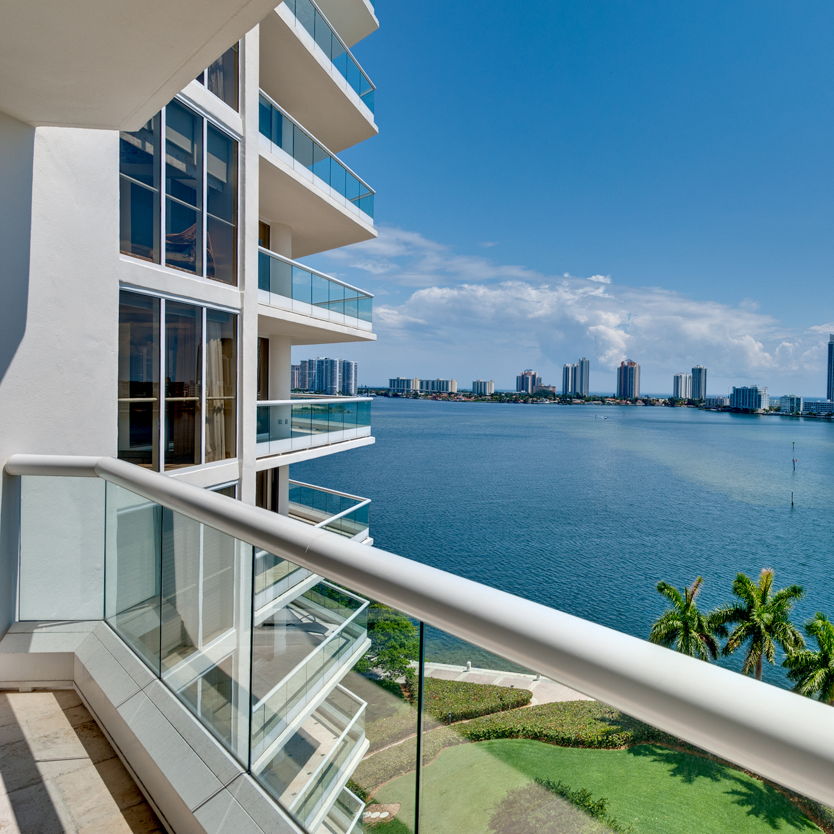
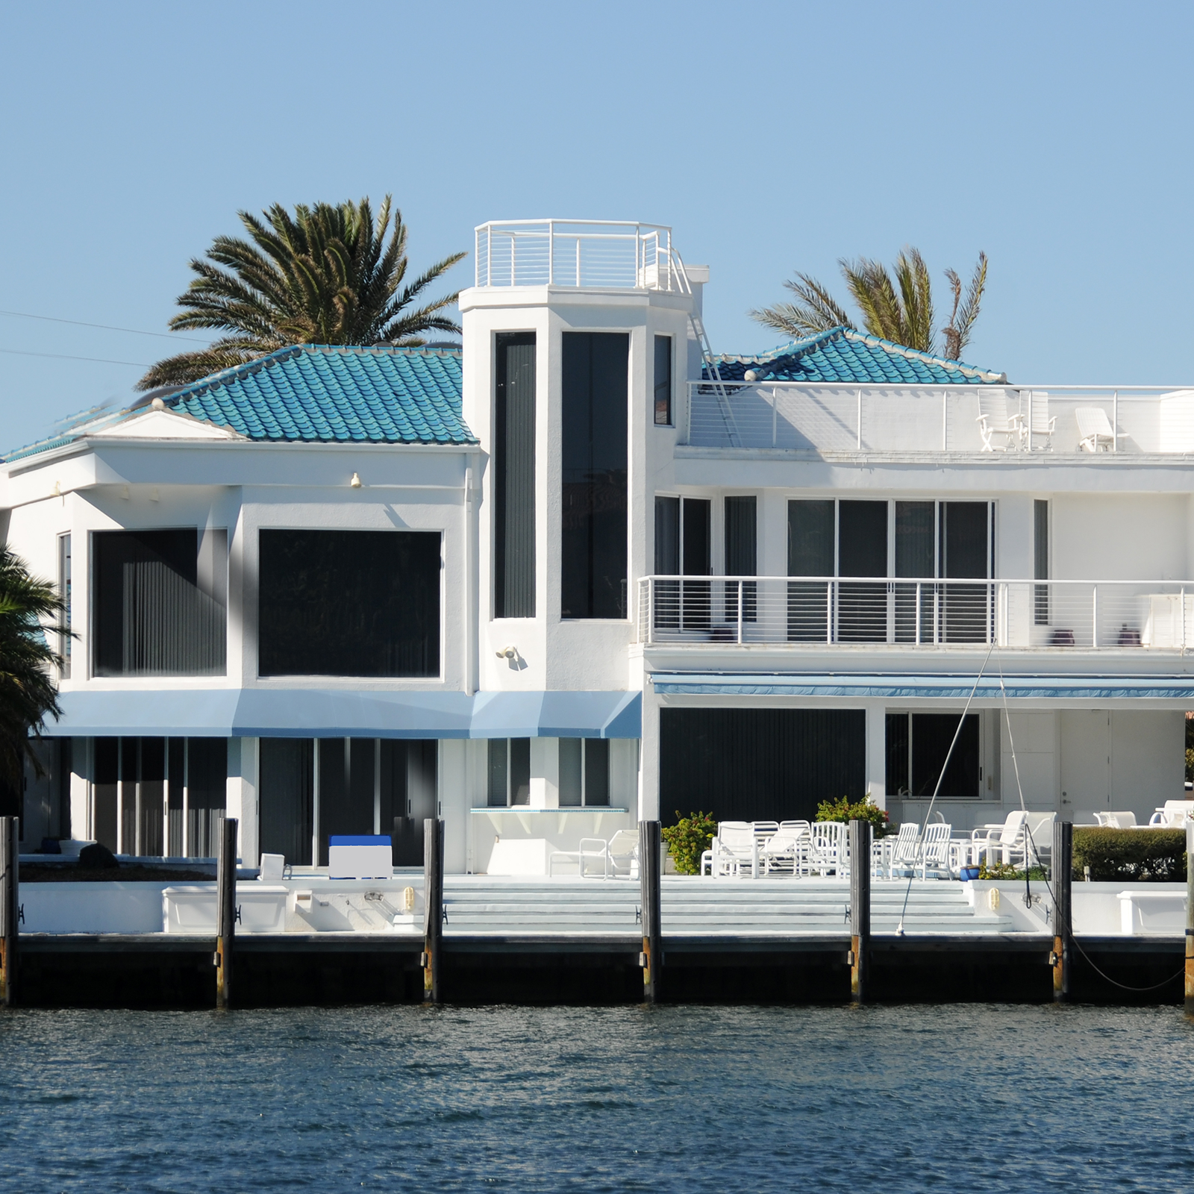
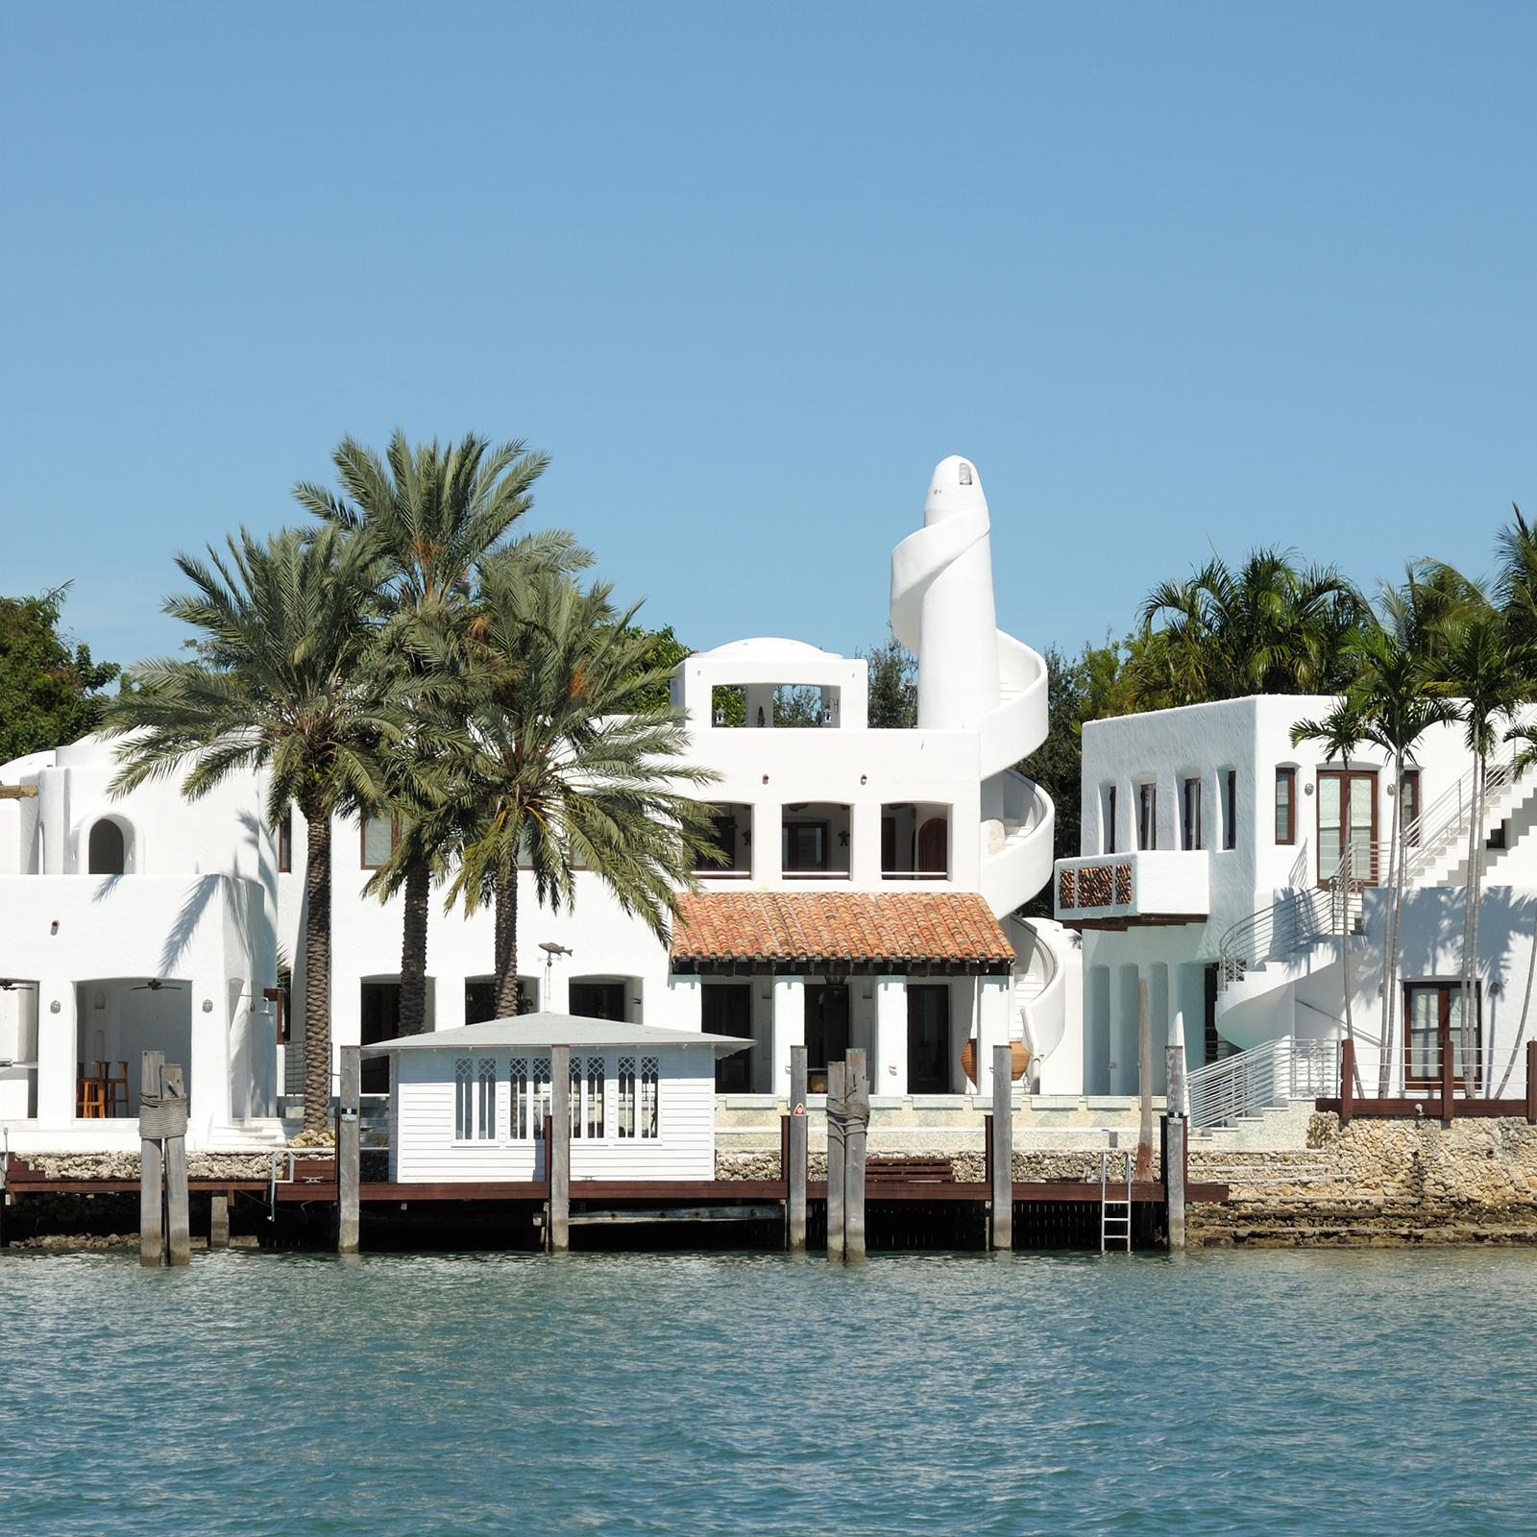
Just Sold
Agent Name, Realtor®
(c) 561.340.1200 | (e) a.agent@langrealty.com
WWW.LANGREALTY.COM

