Slide 1
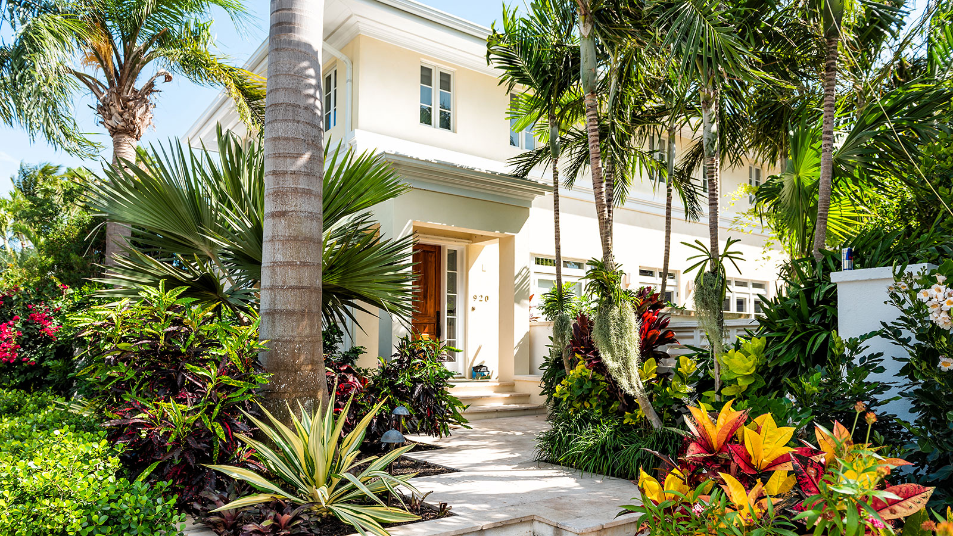
Price
Reduced from
$999,900 to:
$699,900
www.langrealty.com
920 S. Olive Avenue | West Palm Beach
5
Contact Agent Superman for more info at:
3
(c) 561.222.5555 (e) a.kent@langrealty.com
4,899

