Slide 1
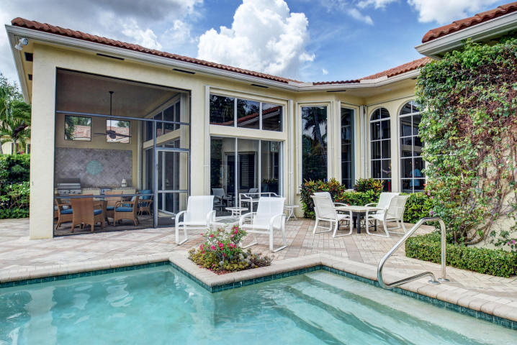
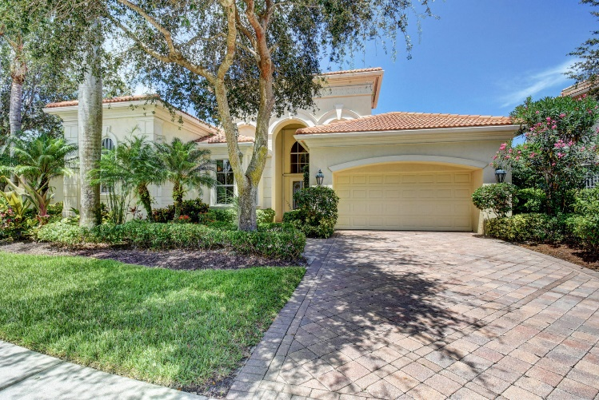
Open House
Two City Plaza
December 19th
12:00PM - 2:00PM
701 S. Main St.
Delray Beach, FL 33444
For More Information
561.340.1200 | a.realtor@langrealty.com
WWW.LANGREALTY.COM

