Slide 1
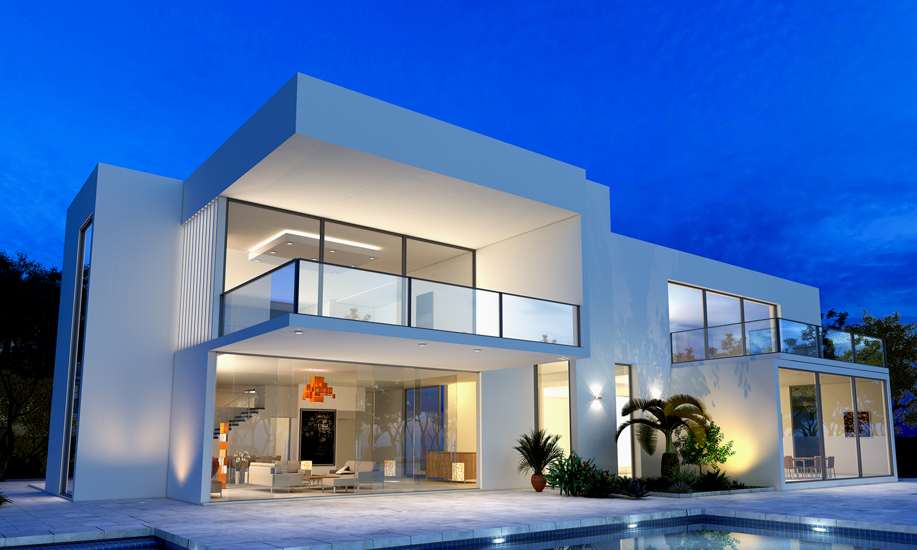
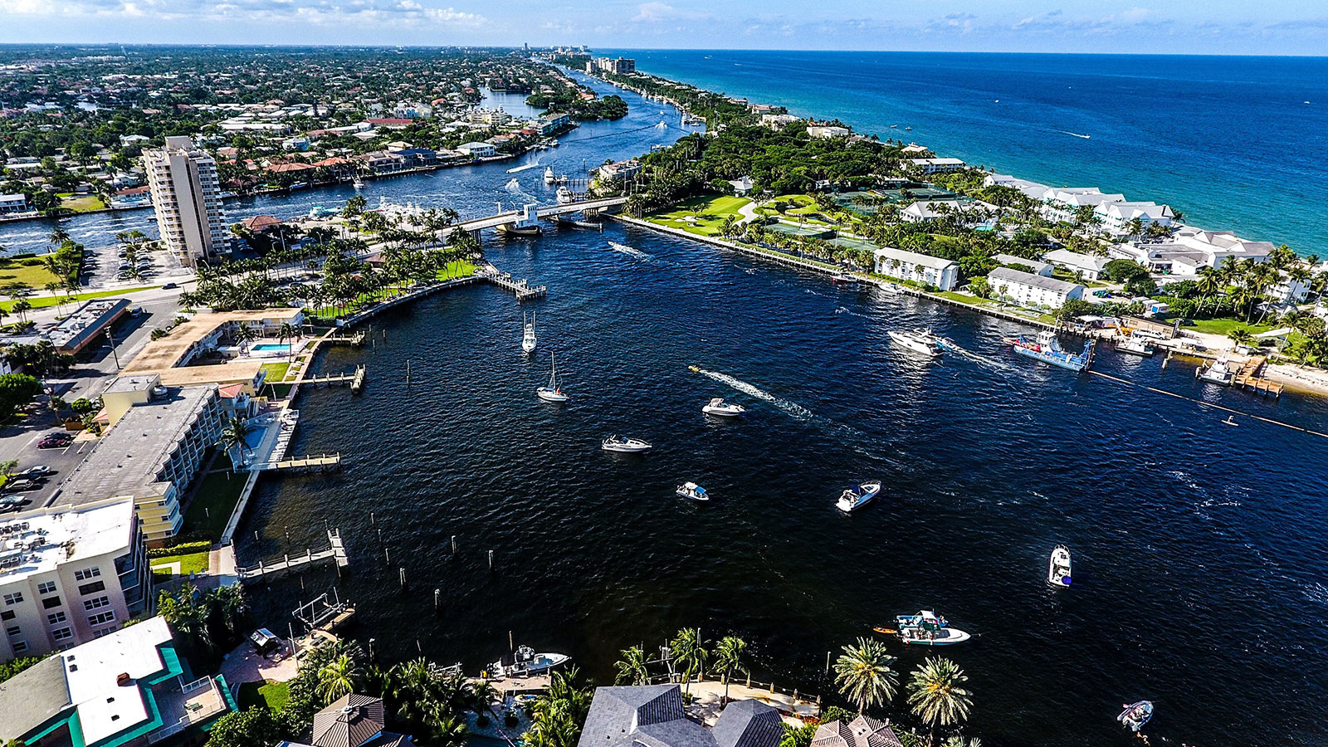
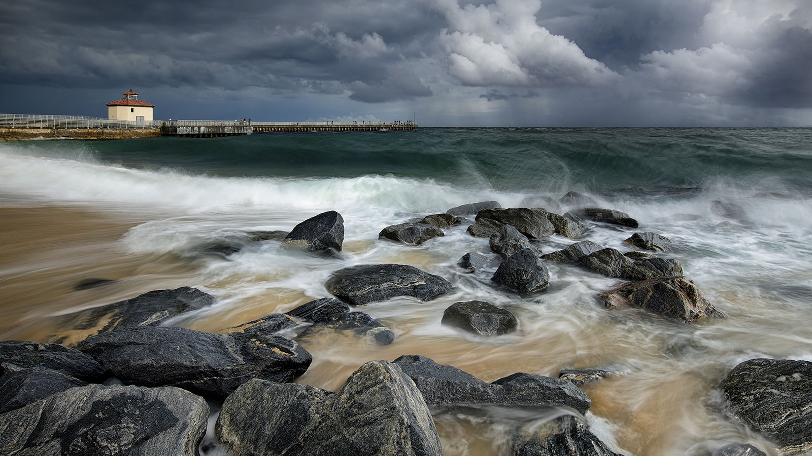
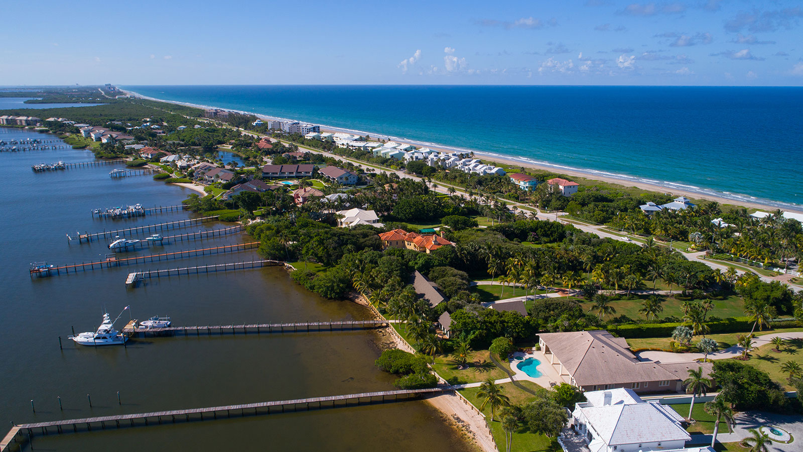
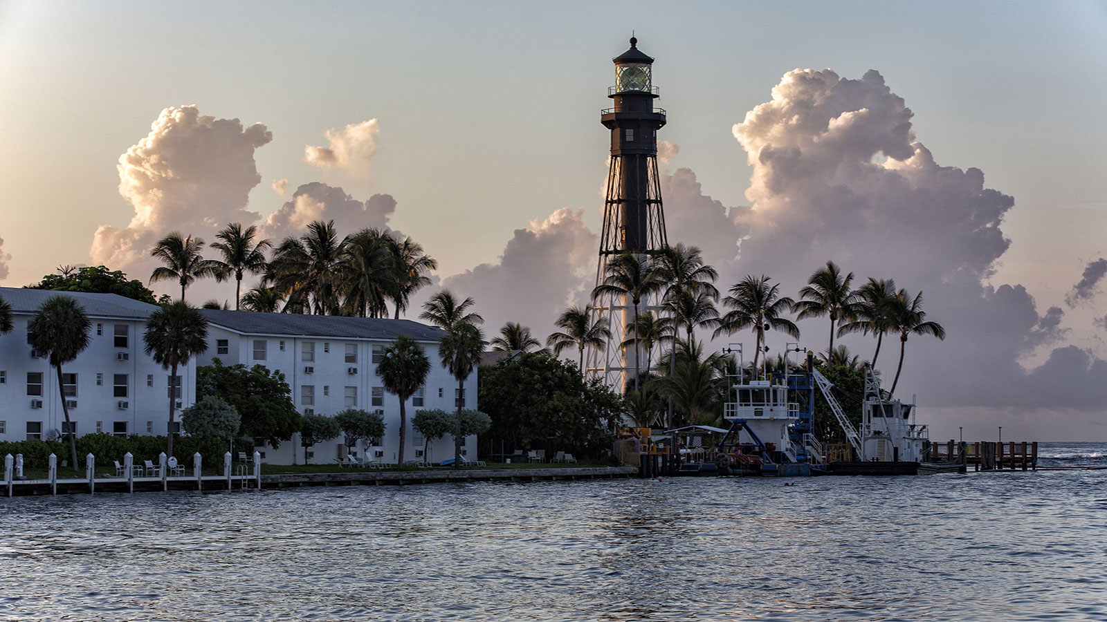
NEW LISTING!
2
700 S. Federal Hwy. | Delray Beach
2
This beautiful, barely lived in, well maintained and alluring 2 bedroom 2 bath PLUS DEN, with Inter-coastal and Ocean views from the spacious balcony, upgraded marble floors throughout, elegant granite counter tops. Stainless Steel Appliances & much more makes this a unique opportunity!
2,200
$1,299,900
Contact Johnny Agent for more information
561.340.1200 | a.agent@langrealty.com
WWW.LANGREALTY.COM

