Slide 1
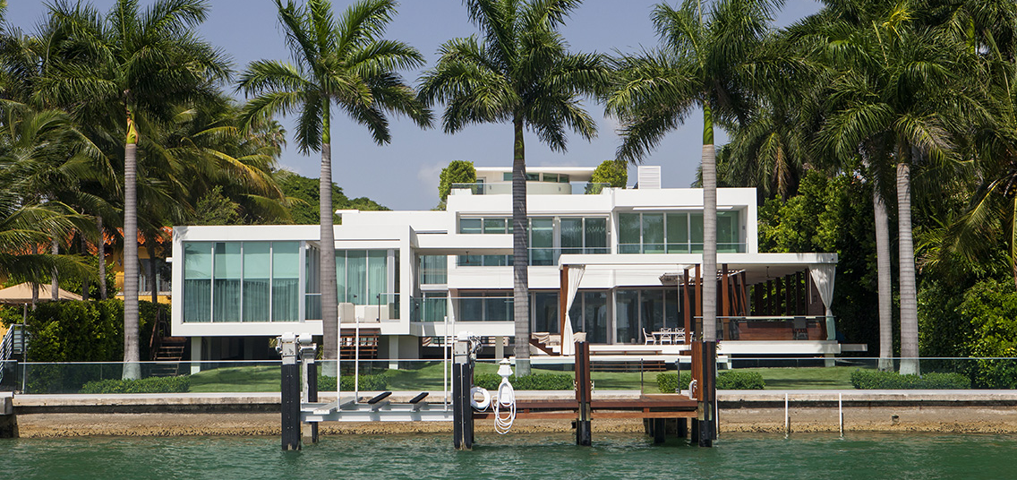
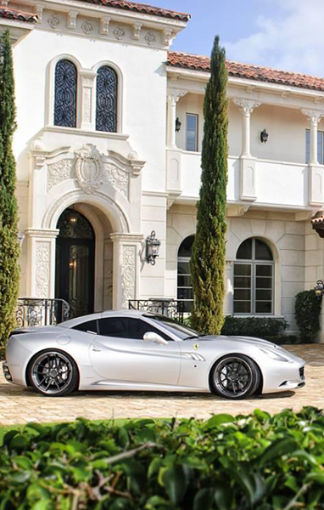
Brokers Open
Two City Plaza
701 Ocean Ave.
Boynton Beach, FL 33435
Tuesday May 25th
12:00PM - 2:00PM
For more information:
Agent Name, Realtor®
(c) 561.340.1200 | (e) a.agent@langrealty.com
WWW.LANGREALTY.COM

